Slide 1
System Views
PO Portal

Slide 2

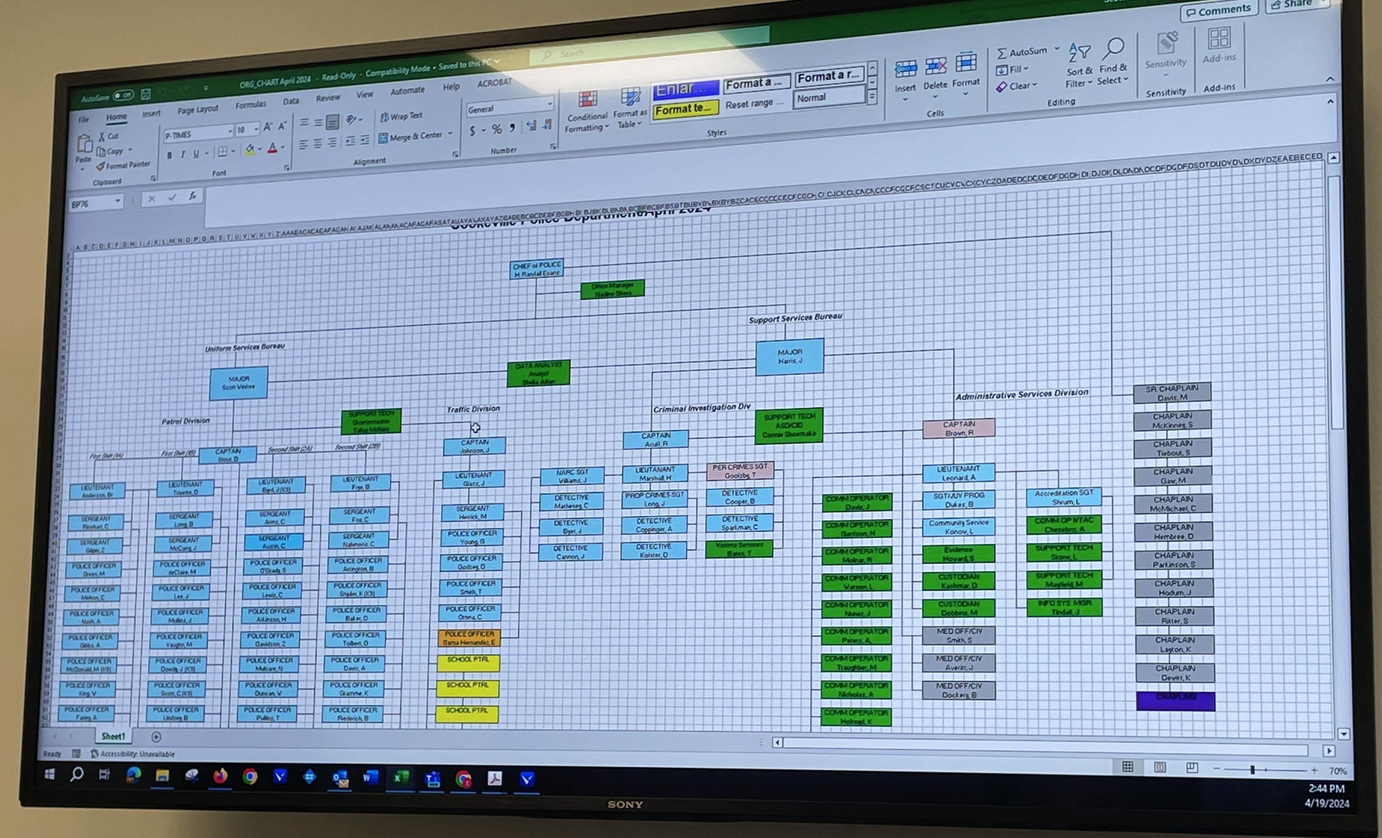
Roles
chief
major
captain
city manager
support staff (Nadeen, James, Connie)
lieutenant
officer
vendor contact
financial
Internal IT/Tech support (Jason)

Slide 3
Permissions
create/edit/delete vendor (major, support staff, IT/Tech, chief)
create/edit/delete vendor contact (major, support staff, IT/Tech, chief
Create request (officer, captain, major,
chief, support staff, internal IT/Tech)
Reject request (lieutenant, captain, major, chief)
Escalate request(lieutenant, captain, major, chief)
Create PO from request (major, chief)
Create PO (major, chief, support staff)
Reject PO (major, chief)
Sign as Fiscal Authority (major)
Sign as Chief (chief)
View permissions (internal IT/Tech, major, chief)
Manage permissions (internal IT/Tech, major, chief)
Sign as city manager (city manager)
Pay invoice (finance)

Slide 4
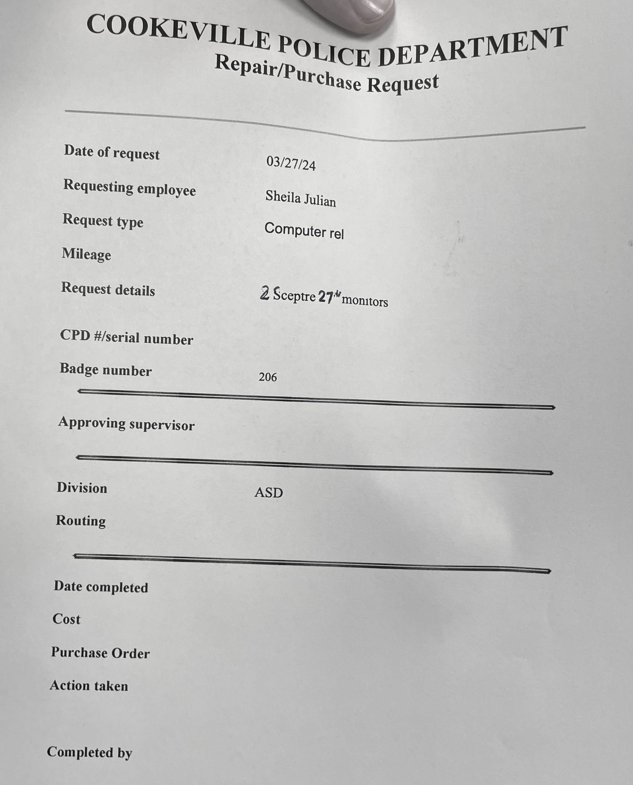
Object: repair_request
date_of_request
requesting_employee
request_type
milage
request_details
cpb_number or serial_number
badge_dumber
approving_supervisor
divison
routing
date_completed
cost
purchase_order
action_taken
completed_by

Slide 5
Object: purchase_request *(looks just like a PO and turns into a PO)
title_of_the_document: “Purchase Request”
po_number
date_created
created_by
vendor (link to vendor_number)
vendor_contact
total_cost (calculated total value of the whole PO )
fiscal_authority_signature
chief_of_police_signature
city_manager_signature (only required when total greater than $1,000)
date_change_to_po (track when it becomes a PO)

Slide 6
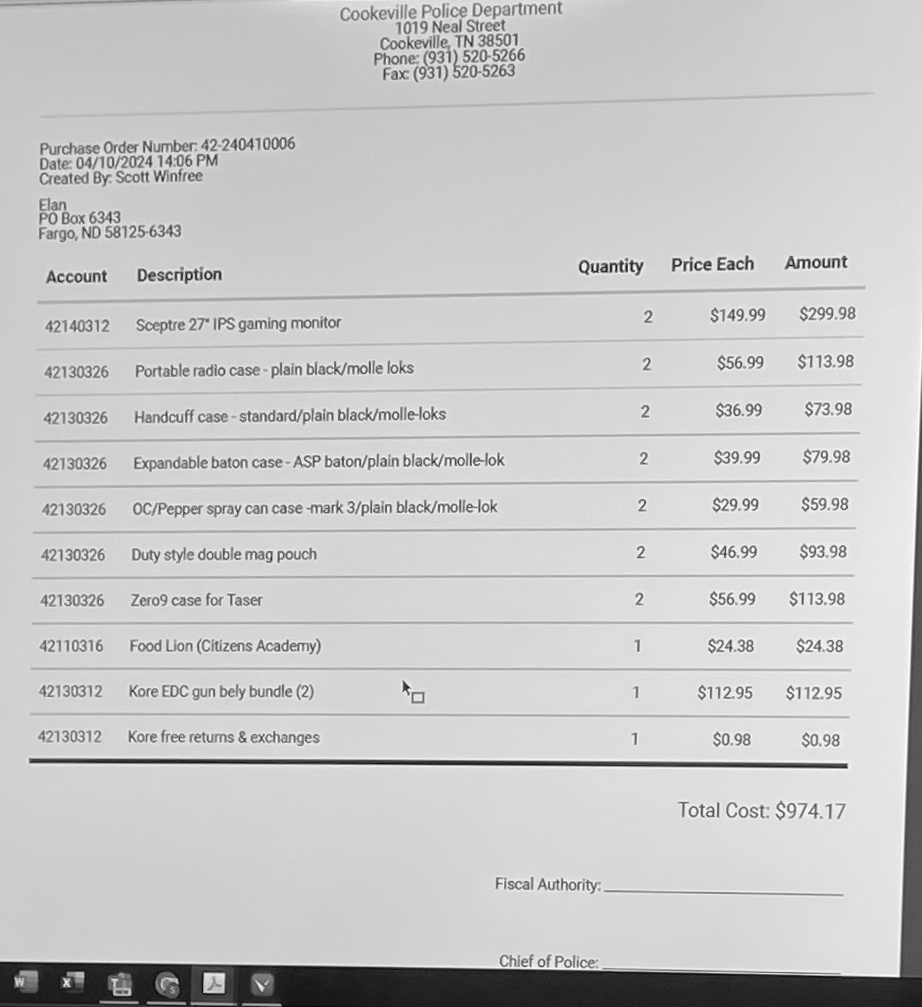
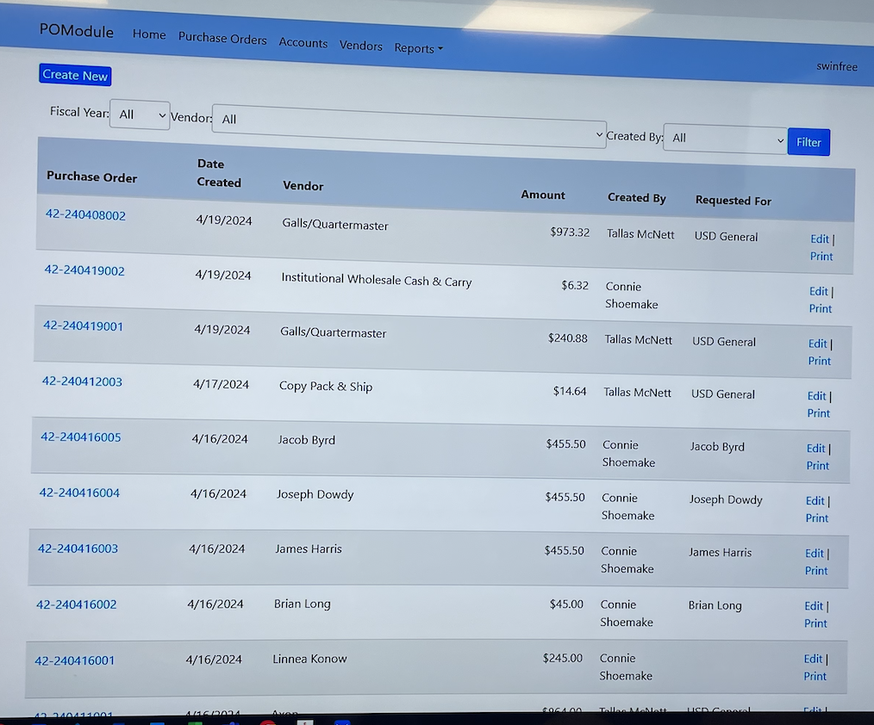
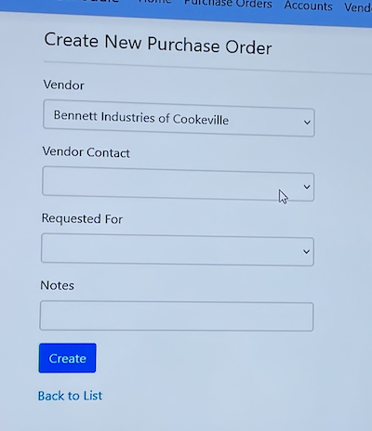
Object: purchase_order
title_of_the_document: “Purchase Order”
po_number
date_created
created_by
vendor (link to vendor_number)
vendor_contact
total_cost (calculated total value of the whole PO )
fiscal_authority_signature
chief_of_police_signature
city_manager_signature (only required when total greater than $1,000)
Sub-Object: line_item
account_number (police account to bill)
description
quantity
price_each
amount (calculate quantity times price each)

Slide 7
Object: invoice
invoice_number
po_number
payment_due_date
vendor_number
status (is it paid yet?)

Slide 8
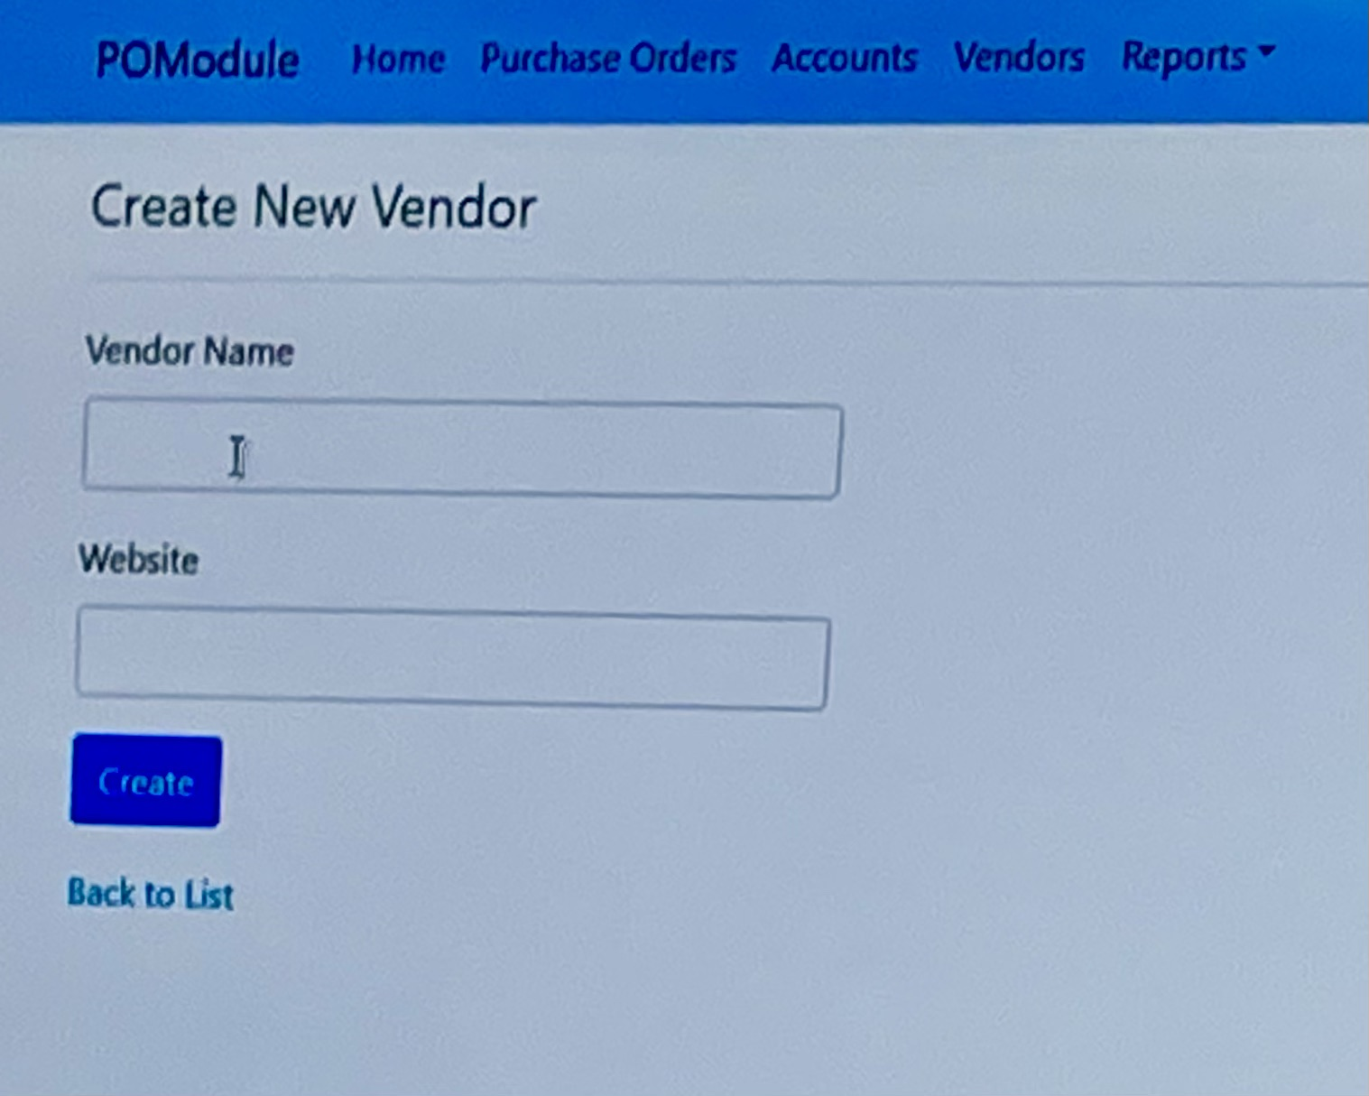
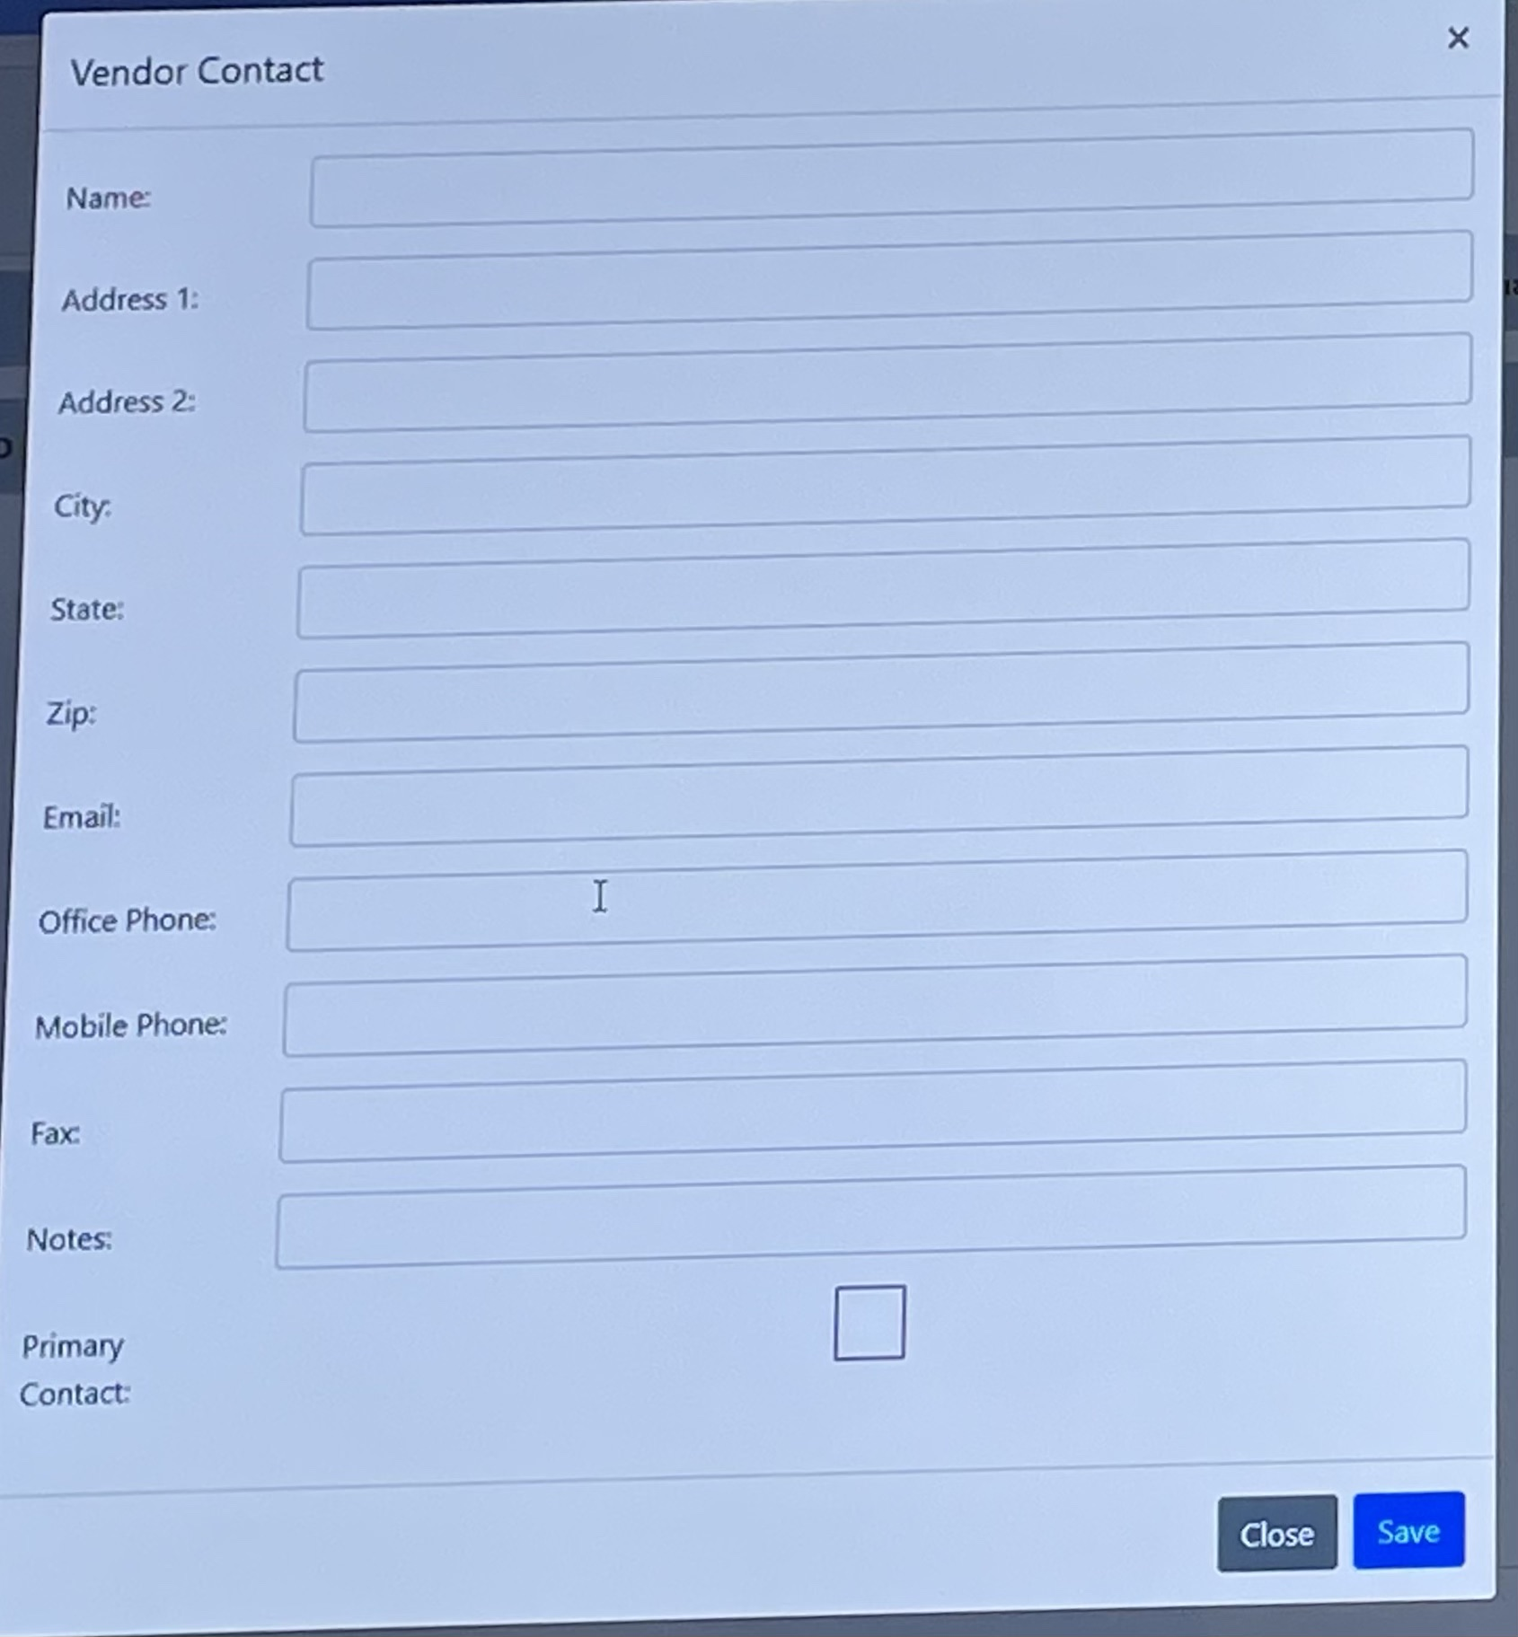
entity: vendor
vendor_number (random number)
vendor_name (of the company)
website
Sub-entity: vendor_contact
name
address_1
address_2
city
state
zip
email
office_phone
mobile_phone
fax
notes
primaryContact(yes/no)

Slide 9
Task: Create PO from request less than $1,000
reject request
create request
reject request
escalate request
reject PO
create PO from request
signature: fiscal authority
officer, captain, major, chief, lieutenant support staff, IT/Tech
signature: chief
pay
lieutenant
captain, major, chief
major, support staff, chief
major, support staff
* captain needs to be informed what his officers are requesting
chief
finance

Slide 10
Task: Create PO less than $1,000
For Example: allowed credit card purchase was made, and a PO is created retroactively
reject PO
create PO
signature: fiscal authority
signature: chief
major, support staff chief
major, support staff
chief

Slide 11
Task: Create PO from request with total greater than $1,000 but less than $10,000
reject request & log
create request
reject request & log
escalate request
chief reject PO
city manager reject PO
create PO from request
signature: fiscal authority
signature: chief
signature: city manager
vendor
create quote (vendor wants PO num to verify incumbered funds)
signature: chief
vendor: create invoice
finance pays
signature: fiscal authority
signature: city manager
* note: when finance pays matters, so track due date

Slide 12
Future TODO Task: Purchases between $10,000 and $25,000
requires another special form
requires three separate bids (unless the state already approved a vendor)

